Slide 1





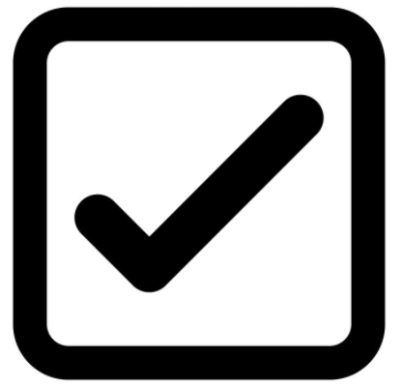
TRANSFER
From account
Select
To account
Select
Amount $
$
$0.1 – 10000
Schedule for date
Start
Select
End
Select
Frequency
Select
Limit 2 times/week
Note: Between your account and U.S. bank account only
Next

Slide 2
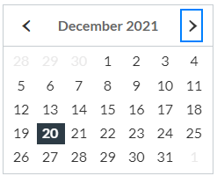
TRANSFER
From account
Select
Checking
To account
Saving
Select
Credit Card
Amount $
$500.00
$0.1 – 10000
Schedule for date
Start
Select
End
Select
Frequency
Select
Limit 2 times/week
Note: Between your account and U.S. bank account only
Next

Slide 3

TRANSFER
From account
Checking
To account
Saving
Amount $
$500.00
$0.1 – 10000
Schedule for date
Start
01/21/2021
End
Select
Error!
Frequency
Select
Can’t process it. Please check the schedule is not more than 30 days
Limit 2 times/week
Note: Between your account and U.S. bank account only
Next

Slide 4
TRANSFER
From account
Checking
To account
Saving
Amount $
$500.00
$0.1 – 10000
Schedule for date
Start
12/20/2021
End
06/30/2022
Frequency
Select
Once a week
Limit 2 times/week
Biweekly
Once a Month
Note: Between your account and U.S. bank account only
Next

Slide 5
Review
From account
Checking
To account
Saving
Amount $
$500.00
Schedule for date
12/21/2021
Frequency
Once a week
Back
Next
Cancel

Slide 6
Confirm
From account
Checking
To account
Saving
Amount $
$500.00
Schedule for date
12/21/2021
Frequency
Weekly
Back
Cancel
Confirm

Slide 7
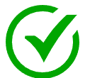
Transaction Confirmation
Your transaction was completed successfully!
Transaction ID
123456789
From account
Checking
To account
Saving
Amount $
$500.00
Schedule for date
12/21/2021
Frequency
Weekly

